Slide 1



Talend Cloud Architecture Cloud Engine
Status & Logs (HTTPS)
Customer data in transit
Metadata in transit (HTTPS)
Cloud Platforms
SaaS Apps
Cloud Engine
Firewall
Firewall
Talend Studio
On-premises Apps & Databases

Slide 2


Talend Cloud Architecture Remote Engine On Premise
Status & Logs (HTTPS)
Customer data in transit
Metadata in transit (HTTPS)
Firewall
Firewall
Talend Studio
Remote Engine
On-premises Apps & Databases

Slide 3
Talend Cloud Architecture Remote Engine On Premise
Status & Logs (HTTPS)
Customer data in transit
Metadata in transit (HTTPS)
Cloud Files
SaaS Apps
Firewall
Firewall
Talend Studio
Remote Engine
On-premises Apps & Databases

Slide 4
Talend Cloud Architecture Remote Engine on Private Cloud
Status & Logs (HTTPS)
Customer data in transit
Metadata in transit (HTTPS)
Private Network/VPC
Cloud Files
Cloud DWH
Remote Engine
Firewall
Firewall
Talend Studio
On-premises Apps & Databases

Slide 5
Talend Cloud (Remote Engine) VS Talend On-Prem
Cloud
Common
On-Premise
TMC
User Management
Job Scheduling & Monitoring
Data movement
Remote Engine
Job Server
User Management
Job Scheduling & Monitoring
TAC
Upgrade
Auto-Upgrade
Monthly Updates
Versioning
GIT/SVN (Source code management)
Manual
Upgrade
In-Build
Artifact Repository (Nexus)
Environments
Log Management
TMC Database
Design
Studio
Individual Module
Artifact Repository (Nexus)
Environments
Log Management
TAC Database
Development
Immediate
Common in both the solutions
Based on server readiness
Up Time
Development
99.9% Up Time
Customer Managed
for each environment (Dev, UAT, Prod etc.)
Talend Managed

Slide 6

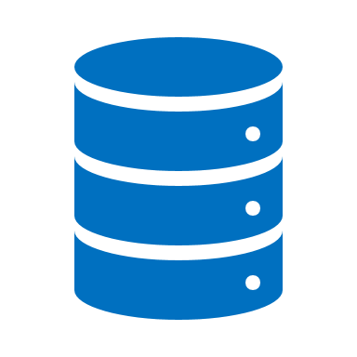
Talend Cloud VS Talend On-Prem
Customer data in transit
Metadata in transit(HTTPS)
Status & Logs (HTTPS)
Firewall
Cloud
On-Prem
TAC, Nexus, Log Server
Server
Environments
APIs
TAC, DQ Databases
Scheduling
User Mgmt.
iPaaS Vs On-Prem
Jobs
Monitoring
Firewall
Firewall
Job Server
Remote Engine
Talend Studio
Job Server
Talend Studio
Remote Engine
Hadoop Cluster
Hadoop Cluster
On-premises Apps & Databases
On-premises Apps & Databases

Slide 7
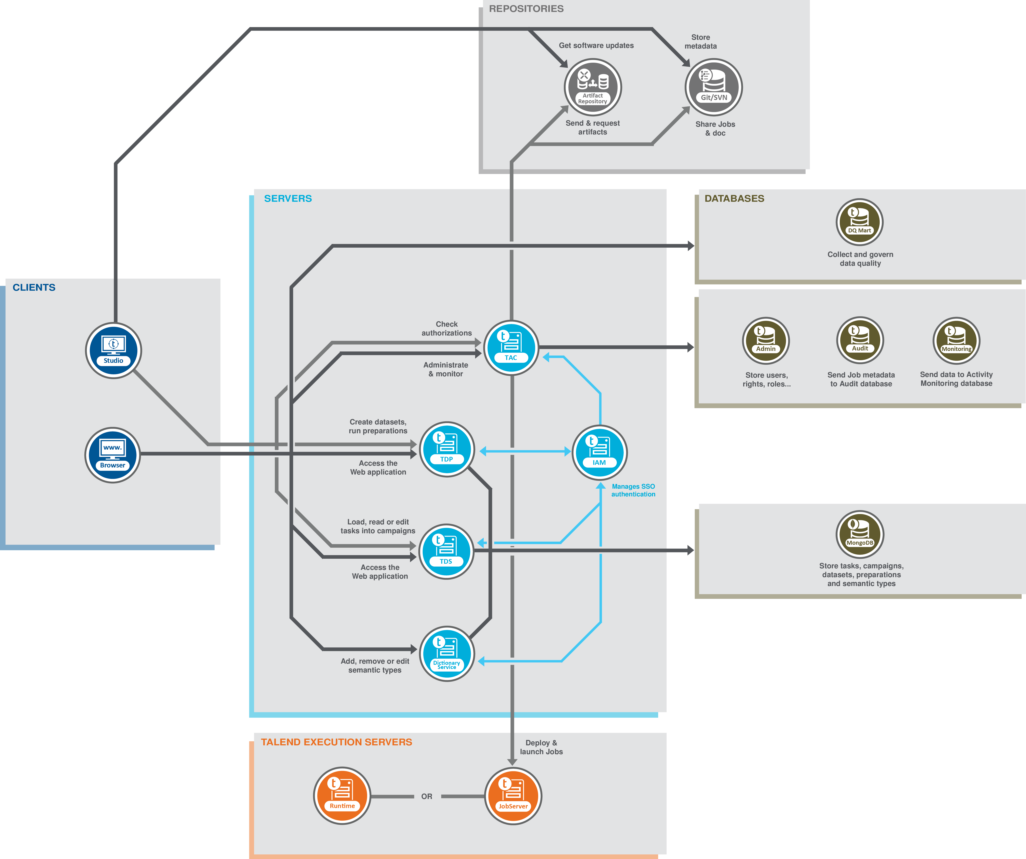
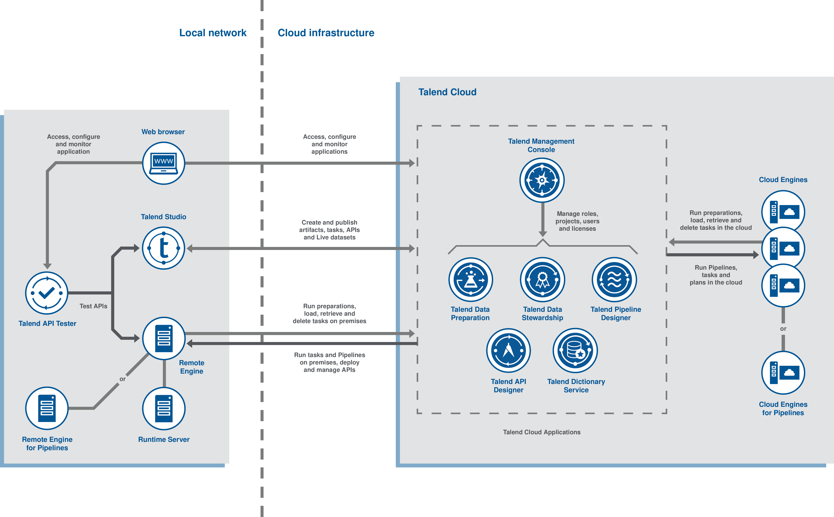
Talend Cloud
Talend On-prem
Install/Maintain/Manage only :
Talend Studios
Remote Engines
Install/Maintain/Manage everything

